Slide 1
WEDDING PLANNING AND BUDGETING TOOL
Group project by-
Mehul Tandon - 23SCSE1011284
Sanskriti Shukla - 23SCSE1011043
Garima - 23SCSE1011741

Slide 2
objective
The objective of the Wedding Planning and Budgeting Tool Java Project is to develop a user-friendly, console-based application that helps couples efficiently manage the various aspects of planning their wedding. The main goals of the project are:
1.Centralized Wedding Management: Provide a tool that allows users to organize and track essential wedding details, such as guest lists, vendor information, tasks, and budgeting, all in one place.
2.Budget Tracking: Enable users to set a total budget and track expenses in different categories, helping them stay within their financial limits while planning the event.
3.Task Organization: Assist users in creating, managing, and tracking the progress of various wedding tasks, ensuring timely completion of important milestones.
4. User-friendly Interaction: Offer a simple, menu-driven interface to ensure ease of use for individuals without technical expertise.
By achieving these objectives, the project aims to simplify the wedding planning process, reduce stress, and ensure better financial and logistical management of the event.

Slide 3
Problem statement
Lack of Budget Tracking
Description: Couples often struggle to keep track of their wedding expenses, leading to overspending and financial stress.
Solution: Develop a feature that allows users to input estimated and actual costs, providing visualizations to compare budgeted vs. actual spending.
Time Management
Description: With so many tasks to complete before the wedding, couples often find it challenging to allocate their time effectively
Solution: Introducing a scheduling feature that provides reminders for key tasks and deadlines. This can include a countdown to the wedding date and notifications for upcoming tasks, helping couples stay on track.

Slide 4
Guest Management
Description: Managing a guest list can be a daunting task, especially when dealing with RSVPs and meal preferences.
Solution: Integrate a guest management system that allows users to easily add guests, track RSVPs, and manage meal preferences. The system can generate reports to help with seating arrangements and catering needs.
Budget Overruns
Description: Many couples exceed their wedding budgets due to unforeseen expenses or lack of proper tracking.
Solution: Implement a budgeting module that allows users to set a budget, track expenses in real-time, and receive alerts when they are approaching their budget limits. This module can include visual graphs and reports to help users visualize their spending.

Slide 5
Technical Stacks
Frontend Development
Frameworks/Libraries:
React: For building dynamic user interfaces.
Vue.js: An alternative for a progressive framework.
Languages: HTML5, CSS3, JavaScript (ES6+)
Backend Development Language:
Java: As the primary language for business logic.
Framework:
Spring Boot: For building RESTful APIs and managing application logic

Slide 6
Database
MySQL or PostgreSQL: For structured data storage, such as user profiles, guest lists, and budgeting details.
User Interface Enhancements
UI Libraries:
Material-UI or Ant Design: For pre-designed components that enhance the user experience
Data Visualization:
Chart.js or D3.js: To create interactive charts for budgeting insights and spending trends.

Slide 7
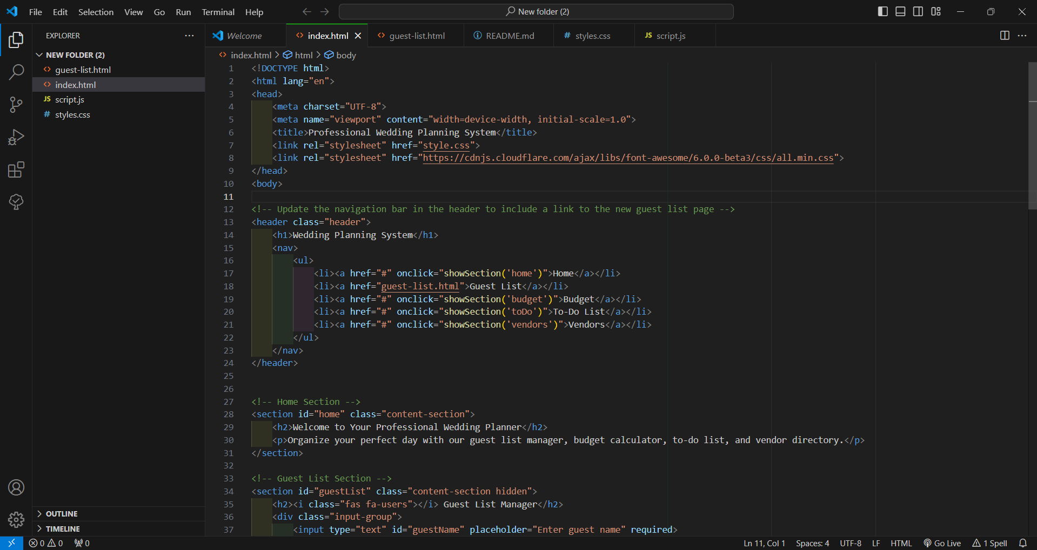
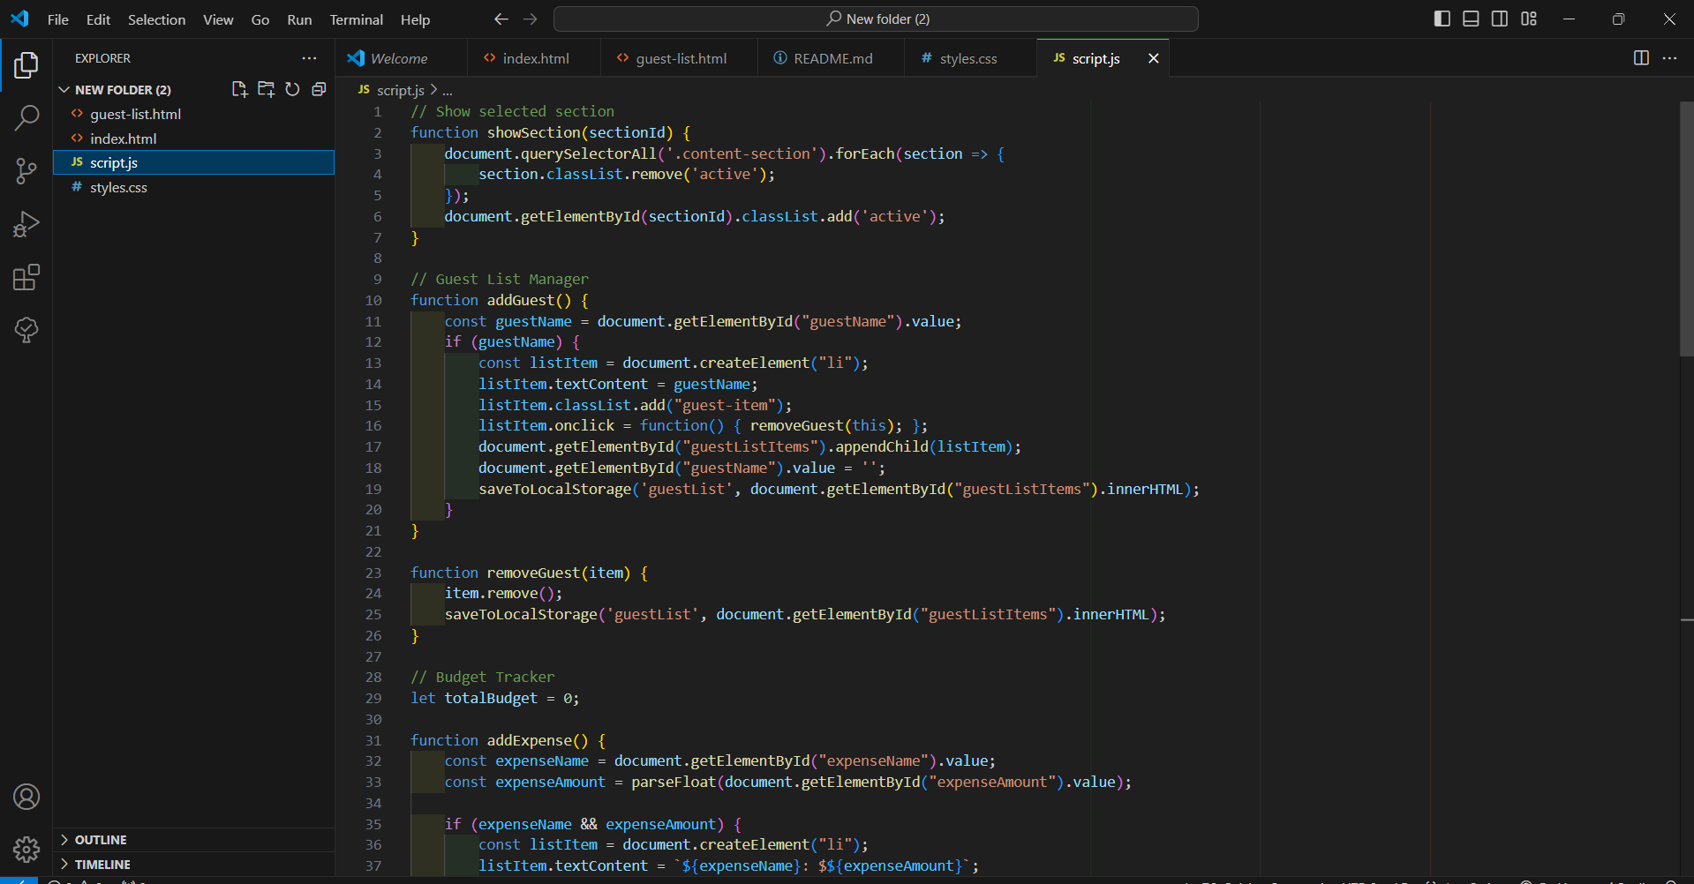
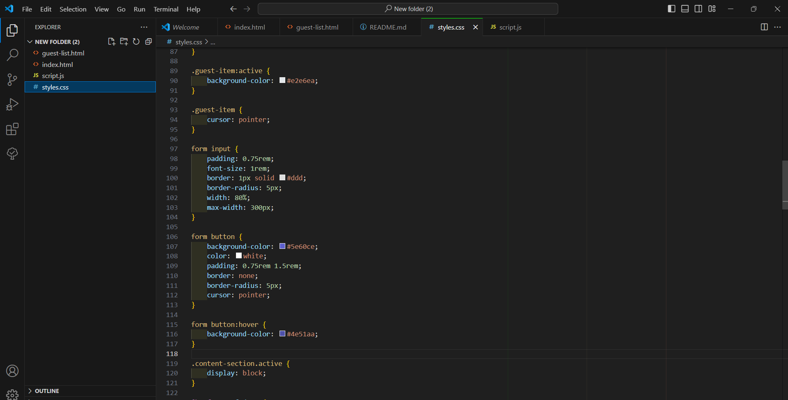
SOURCE CODE

Slide 8
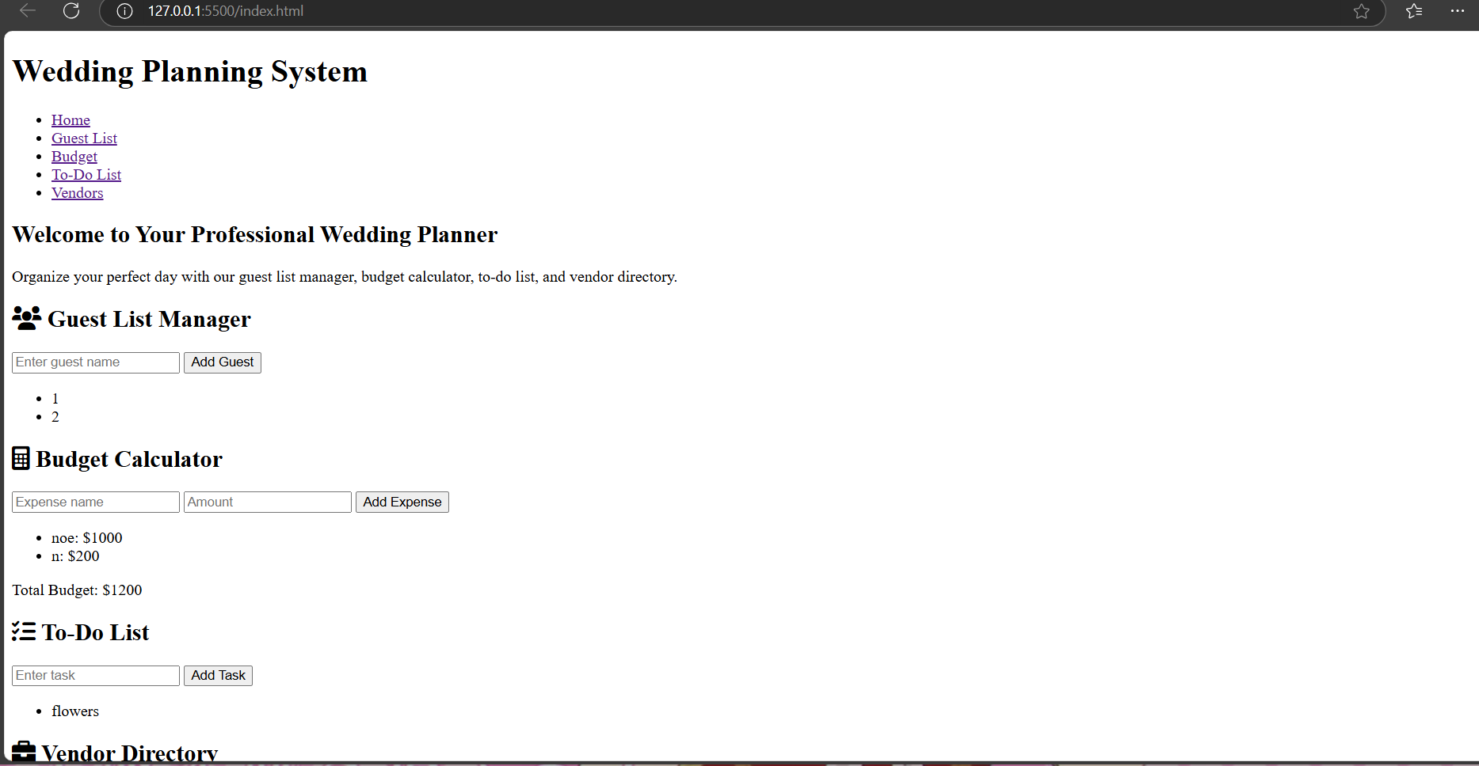
WEB RESULTS

Slide 9
Thankyou!

